Slide 1
GAS LEAKAGE MONITORING AND ALERTING SYSTEM
TEAM ID: PNT2022TMID38668
TEAM MEMBERS
B.A HEMASRI [TM]
(420419205005)
E.PRETHI [TM]
(420419205010)
M.SAKTHI MAHESWARI [TL]
(420419205012)
P.SIVASANGARI [TM]
(420419205016)
INDUSTRY MENTOR
KUMAR JULURI
FACULTY MENTOR
Dr.N.ELAMATHI ME.,Ph.d.,
FACULTY EVALUATOR
M.EZHILVENDHAN ME.,

Slide 2
PRESENTATION OVERVIEW
Abstract
Objectives
System Requirement
Proposed Methodology
Empathy Map
Problem Statement
Solution Architecture
Functional Requirement
Non-Functional Requirement
Technical Architecture
Conclusion
Reference

Slide 3
ABSTRACT
Gas leakage has become a threat and the security issue has to be considered with due importance. Gas leakages in open or closed areas can prove to be dangerous and lethal.
The traditional gas leakage detector systems have great precision but fail to acknowledge a few factors in the field of alerting the people about the leakage.
Therefore, we have used the IOT technology to make a gas leakage detector for smart alerting techniques.
This system provides the information such as when a gas leakage is noticed, sensors in this project are used to notice the gas leakage and immediately turns on the buzzer for the danger indication.
Buzzer is a clear indication of gas leakage.
LCD display is used to display the status of the gas leak.

Slide 4
OBJECTIVES
The aim of this project is to propose and discuss a design of a gas leakage detection system that can automatically detect, alert and control gas leakage.
One of the preventive measures to avoid the danger associated with gas leakage is to install a gas leakage detector at vulnerable locations.
The objective of this work is to present the design of a cost-effective automatic alarming system, which can detect the gas leakage in various premises.

Slide 5
SYSTEM REQUIREMENT
Hardware Requirement
Processor
RAM
:AMD Ryzen 5 5500U with Radeon Graphics 2.10 GHz
: 8.00 GB (5.86 GB usable)
Software Requirement
Operating System
Tools
Language
: Windows 11
: Python 3.7, Node-Red , IBM IOT Platform , MIT App Inventor
: Python

Slide 6
PROPOSED SOLUTION
Problem Statement (Problem to be solved): Monitoring and Detecting the gas leakage in industries at unmanned zone.
Novelty / Uniqueness: We use advanced sensor called Monolithic sensor (MPS) Sensor. Business Model (Revenue Model): Gas leakage monitoring and alerting system is the most efficient and cost-effective technology for producing large quantities of gas in the industries and it helps them to increase the business growth.
Scalability of the Solution: Our system is a reliable one and the installation is ease and the connectivity is well planned. It has extraordinary functionality.

Slide 7








Fig 1.2 Proposed Methodology
Sensors And Arudino Kit set up
Sensed data published to IBM
Cloud
Gas
leakage detected
Displayed in Dashboard
Power and Internet
Displayed in Android Application
Alert the people in the industries

Slide 8
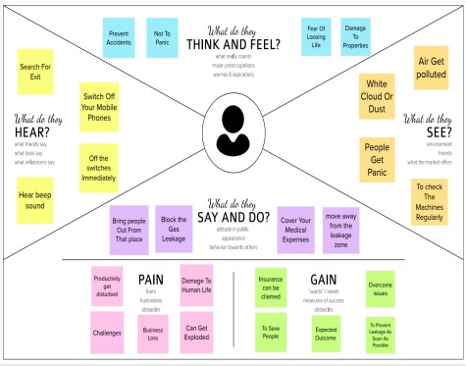
Fig 1.2 Empathy Map
EMPATHY MAP

Slide 9
PROBLEM STATEMENT
The presence of the hazardous gas leakage in work place of industries also stored gases contains gas which exhibits ideal characteristics is used.
The sensors Arduino UNO are widely used to detect the essence of the gas in atmosphere of the industries.
The usage of the gas brings great problem in industries which is excessively used in industries causes destructible impact to the lives and as well as to the hesitate of the people.

Slide 10
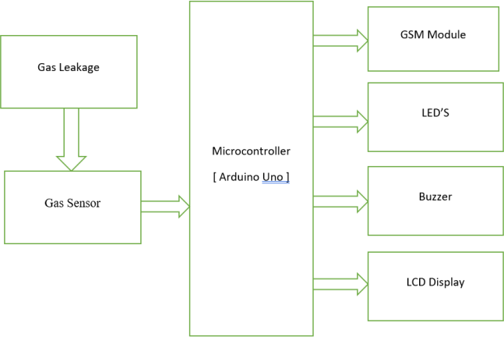
Fig 1.2 Solution Architecture
SOLUTION ARCHITECTURE

Slide 11
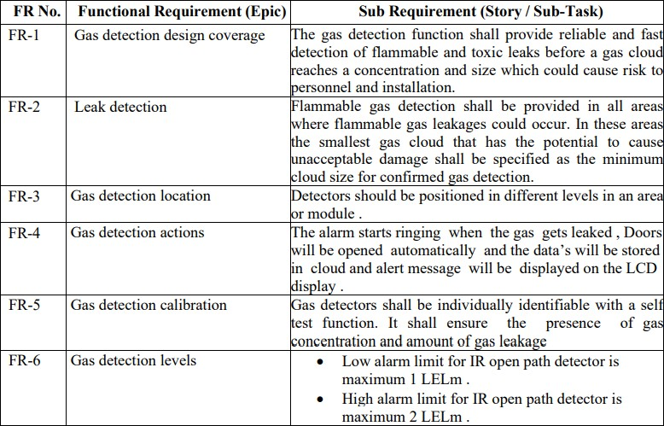
FUNCTIONAL REQUIREMENT

Slide 12
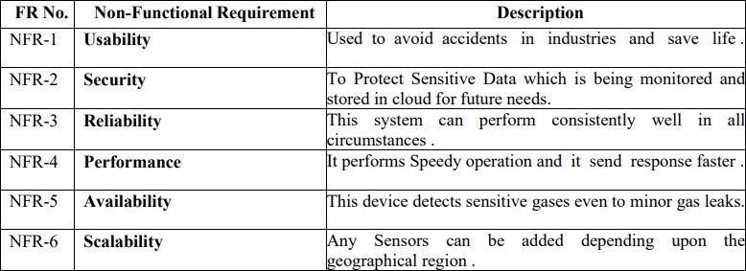
NON-FUNCTIONAL REQUIREMENT

Slide 13
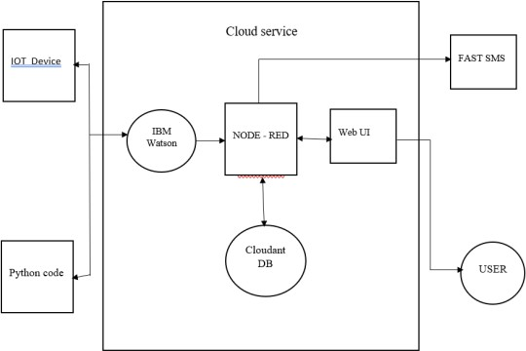
TECHNICAL ARCHITECTURE
The Deliverable shall include the architectural diagram as below and the information as per the table1 & table 2
Fig 1.4 Technical Architecture

Slide 14
TECHNICAL ARCHITECTURE OF GUIDELINES
Include all the processes (As an application logic / Technology Block)
Provide infrastructural demarcation (Local / Cloud)
Indicate external interfaces (third party API’s etc.)
Indicate Data Storage components / services
Indicate interface to machine learning models (if applicable)

Slide 15
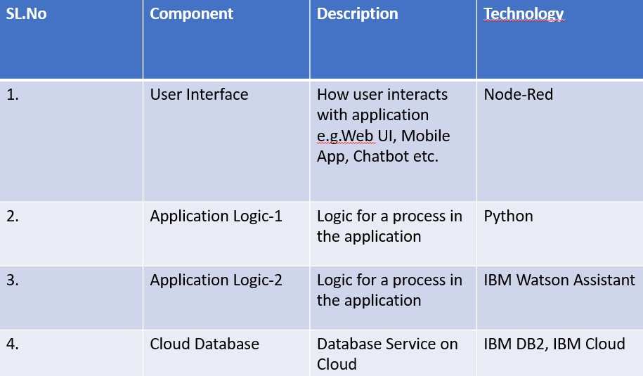
COMPONENTS & TECHNOLOGIES

Slide 16
CONCLUSION
Thus, we would like to conclude that our system mainly focuses on industrial safety. This, provides significance in the safety department.
Also, it leads to raise the economy, because when gas leaks it not only contaminates the atmosphere, but also wastage of gases will hurt our economy.
The need for ensuring safety in workplaces is expected to be the key driving force for the market over the coming years. Therefore, this detector solely can prevent and ensure safety.

Slide 17
REFERENCES
[1] Mr.Sivaprasad Lebaka, N.V.Charan , 2022 Gas leakage detection using GSM Module& Arduino with SMS Alert .
[2] Saurabh Shambharkar, Neha Chourasia ,Papiha Ajmire, 2022 Sensor based Gas Leakage Detector System.
[3] Younus Mohammed Abdulkhaleq, Muntadher Asaad Nadhim , 2022 IOT Based Gas Leakage Detection and Alarming System using Blynk Platforms.
[4] Dr.Suma Christal Mary, Dr.Josphine Leela , 2021 IOT Based Home Safety Gas Leakage Detection and Automatic Booking System.

Slide 18
THANK YOU!

